Slide 1



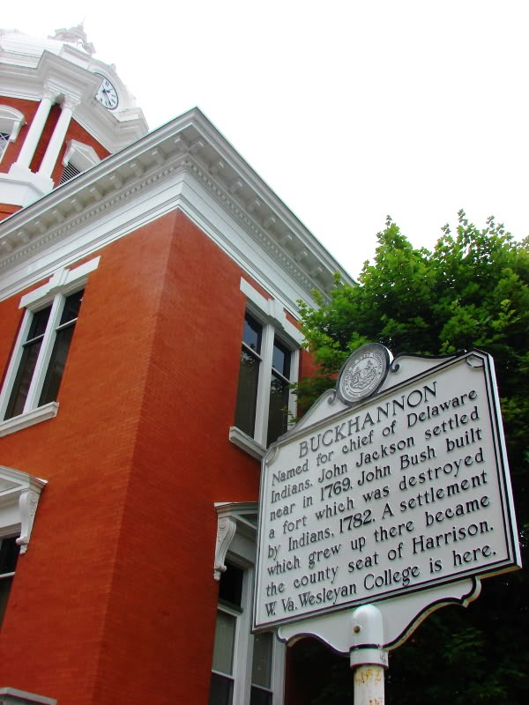
RUSSELL COUNTY
137 Highland Drive, Suite A
PO Box 1208
Lebanon, Virginia 24266
LANDFILL DEVELOPMENT FEASIBILITY
(MOSS III LANDFILL)
Charleston • Morgantown • Winchester, VA
PRESENTER:
David K. Paylor
Vice President of Environmental
Project #: 0103-22-0164
March 8, 2024

Slide 2

RUSSELL COUNTY ENGAGED POTESTA
Identify Health/Safety Issues (regarding citizens)
Evaluate the Feasibility of the Site as a Landfill
Address Unique Site Features
Address Environmental Concerns
Meet/Exceed State Regulations
2

Slide 3
SITE EVALUATION
REVIEWED FATAL FLAW SCREENING REPORT
Further Evaluation Proposed
Stability of slopes/types of materials/dams
Verification of limits of underground mining
Geologic faults/seismic activity
SITE VISIT
Bowl-shaped depression
Existing coal refuse
Adjacent dams
3

Slide 4
SITE EVALUATION
LETTER REPORT WITH RECOMMENDATIONS
No issues identified that make the site “unpermittable”
Detailed evaluation/proper technical design are critical to addressing issues identified for further assessment
RECOMMENDATIONS
Landfill liaison
Leachate collection/detection layers
Gravity flow to outside landfill
Adequate leachate treatment plan
Remove ponded water
4

Slide 5
SITE EVALUATION
RECOMMENDATIONS
Remove unsuitable material
Coal fine/soft soils
Acceptable firm foundation
Evaluate the suitability of coarse coal refuse
Detailed Stability Analyses
Natural soils
Coarse coal refuse
Existing coal refuse dam embankments
Proposed liner system
Landfill waste
5

Slide 6
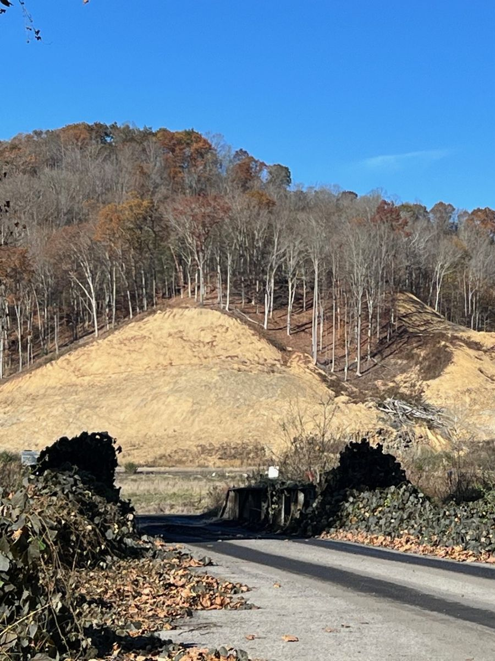
SITE EVALUATION
RECOMMENDATIONS
Mine Safety & Health Administration (MSHA)
Approval for fills impacting Dams 1 and 2
Evaluation of Underground Mining
Horizontal/vertical location
Height of mine void
Angle of draw
6

Slide 7
ADDITIONAL REQUIREMENTS
Design/implement mine stabilization program
e.g., full roof contact grouting
Slope stability for all components
Prepared subgrade
Coal refuse
Landfill liner system
Slopes/embankments of coal refuse fills/impoundments
Natural ground slopes (under/adjacent to landfill)
Temporary/final slopes of landfill (waste placement, cover material)
Material strength parameters based on sampling/laboratory analyses
7

Slide 8
ADDITIONAL REQUIREMENTS
Develop dewatering plan
Evaluate bearing capacity, settlement/consolidation of subgrade, etc.
Leachate storage
Liner material able to elongate due to stress/strain from mine subsidence
Meet/exceed Virginia Department of Environmental Quality Regulations
8

Slide 9
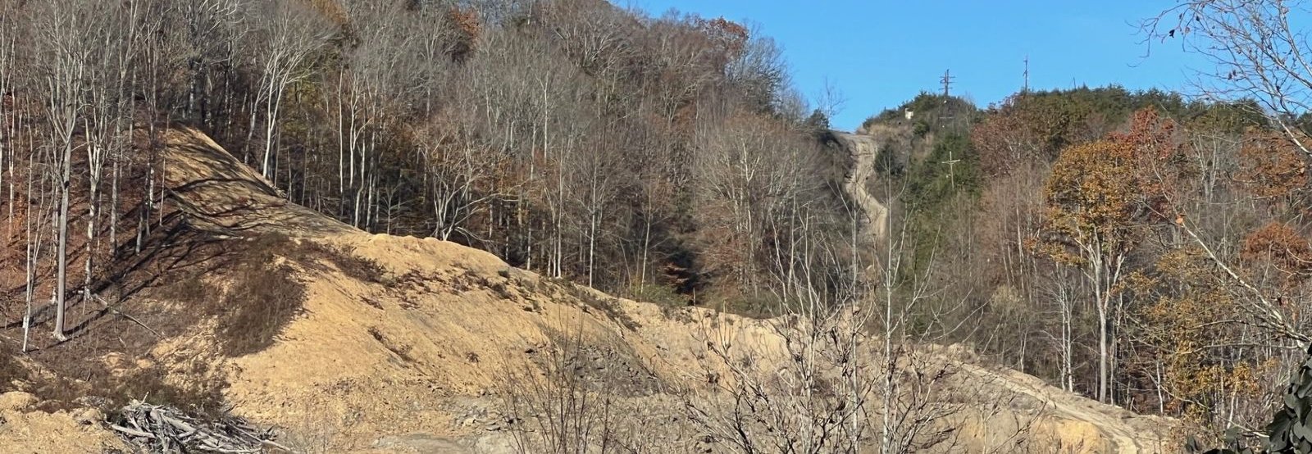
SUMMARY
Meet/exceed Virginia Department of Environmental Quality Regulations
No fatal flaws identified to date
Detailed evaluation/proper technical design are critical to addressing issues identified for further assessment
9

